Slide 1
Traffic Engineering with Software Defined Networking
Guangtong Shen Haofan Feng
shen260@purdue.edu feng189@purdue.edu

Slide 2
Motivation
Background and Problems
The wide area network (WAN) that connects the data-centers (DC) is critical infrastructure for providers of online services. However the WANs have low efficiency (40%-60% avg utilization of busier links)
Several causes:
1. Poor coordination between interactive and background traffic
2. Each flow applies locally optimal routing strategy, which may result to congestion of the network
Our focus:
Find alternative routing algorithms to replace the local, static routing strategy

Slide 3
Problem Statement
Problems with static greedy routing algorithms
1. The “best” path may be congested while other available paths remain unconsidered
2. Local optimum may not lead to global optimum

Slide 4
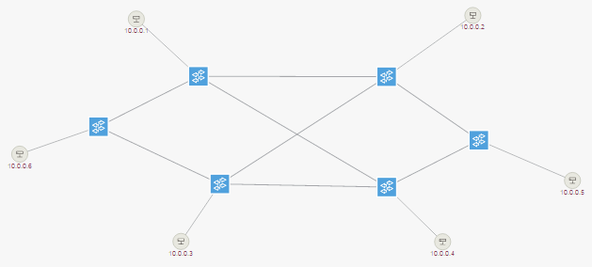
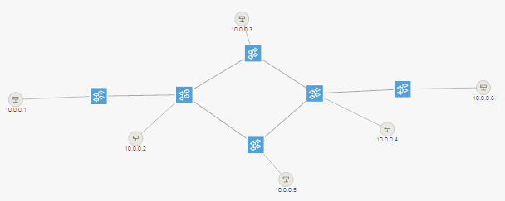
Progress
Use Mininet to virtualize networks as developing environment, connecting to ONOS controller
Open virtual switch (OVS) using openflow 1.3
Limit link bandwidth in Mininet (But the physical OVS port speed reported to ONOS
cannot be configured, we read port speed from a file as a work around)
Add a host to each switch to simulate the ingress flow of each switch
Use Linux command iperf to generate flows at any speed

Slide 5
Progress
Write ONOS App to execute routing strategy
Static widest path
- Consider the link bandwidth
- Select path with the widest bottleneck capacity
Dynamic widest path
- Consider the link bandwidth and current traffic in the network
- Select path according to Remaining bandwidth or Utilization
Multipath Optimal Allocation
- Consider link bandwidth and flow demands
- Linear programming to maximize total flow traffic
(Referring to SWAN paper)

Slide 6
Smallest Utilization Algorithm
1. Use Depth First Search to find all paths from source to destination
2. Calculate utilization rate of each link
(Link utilization = Current occupied bandwidth / Link capacity)
3. Use the highest utilization rate of a link as the utilization rate of the path that link belongs to
4. Sort paths by utilization rate in ascending order
5. Select the first few paths within a tolerance of measurement error.
6. From this narrowed-down set, select the path with smallest number of hops to forward the flow

Slide 7
Widest Remaining Bandwidth
Improvement
Path selection is just based on absolute remaining bandwidth of a path, rather than the utilization rate.
This makes sense since a big flow will still suffer packet loss if it chooses a path with small utilization rate but small absolute bandwidth.

Slide 8
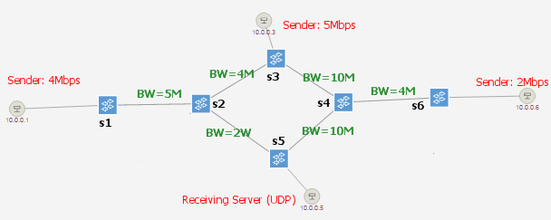
Result Case
Round 1: Start flow one by one, each will last 1min:
H1->H5 4Mbps
H3->H5 5Mbps
H6->H5 2Mbps
Round 2: After all flow complete start in reverse order, each lasts 1min:
H6->H5 2Mbps
H3->H5 5Mbps
H1->H5 4Mbps

Slide 9
Result Case
Static Widest Path?
All flows go through link s4-s5. The total 11 Mbps flow demand cannot be satisfied.
Choose the Smallest Utilization Path?
Round 1, the 4Mbps flow will choose s2-s5 which is not enough for it.
Round 2, the 5Mbps flow will choose s2-s5 which is not enough for it.
Choose the Widest Remaining Bandwidth?

Slide 10
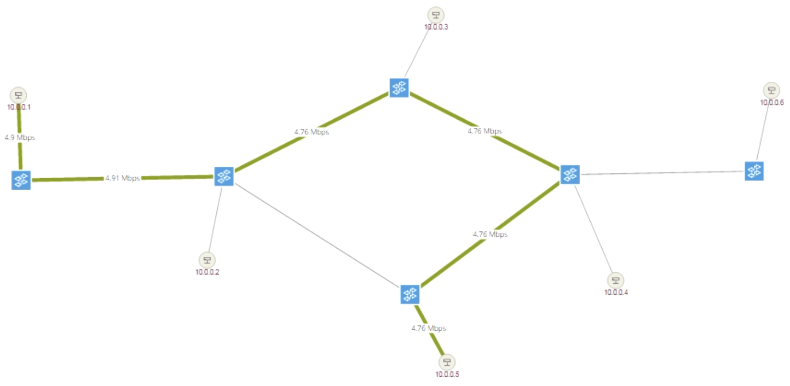
Result Case
Sender: 4Mbps
BW=4M
BW=10M
BW=5M
BW=4M
BW=2M
BW=10M

Slide 11
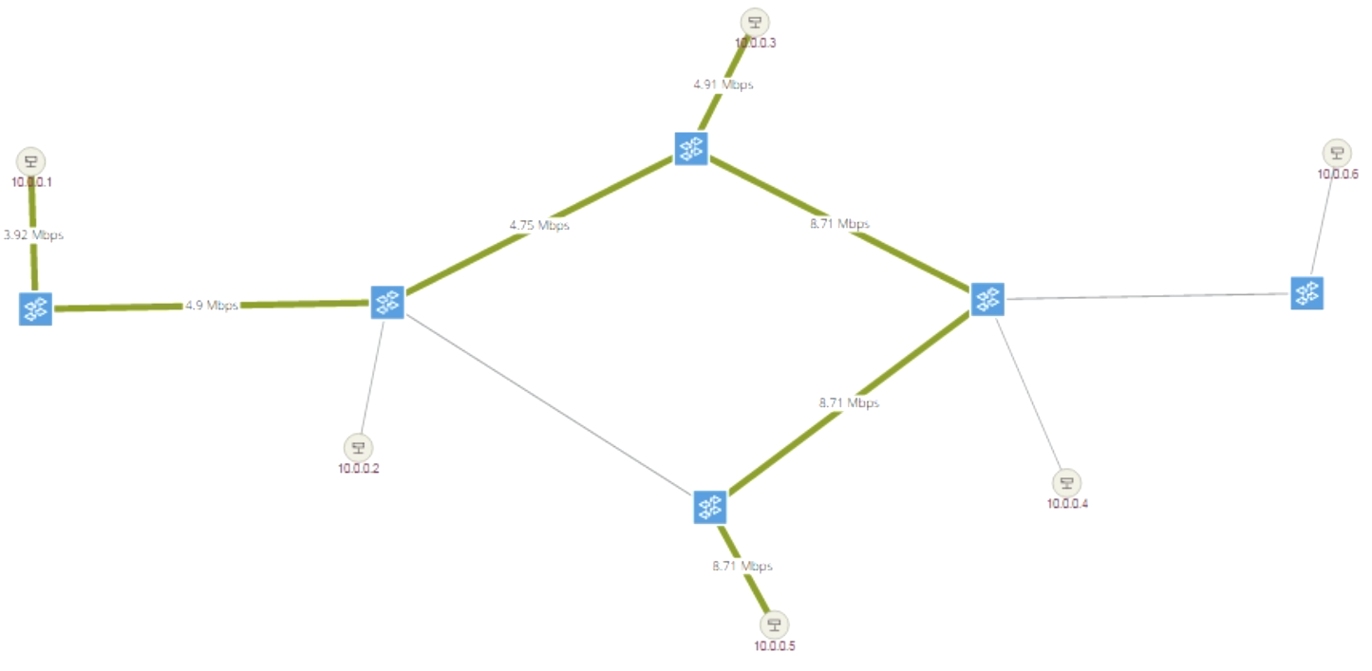
Result Case
Sender: 5Mbps
Sender: 4Mbps
BW=4M
BW=10M
BW=5M
BW=4M
BW=2M
BW=10M

Slide 12
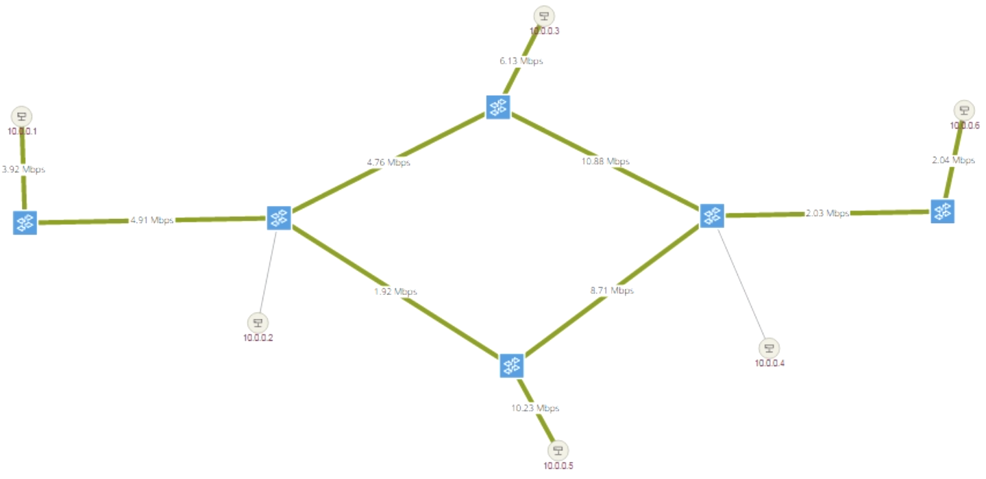
Result Case
Sender: 5Mbps
Sender: 2Mbps
Sender: 4Mbps
BW=4M
BW=10M
BW=5M
BW=4M
BW=2M
BW=10M

Slide 13
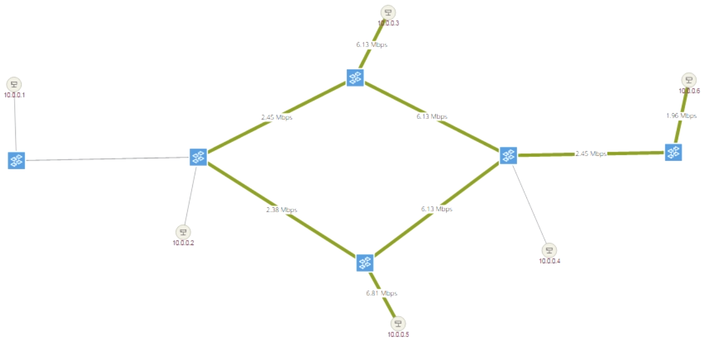
Result Case
Sender: 5Mbps
Sender: 2Mbps
Sender: 4Mbps
BW=4M
BW=10M
BW=5M
BW=4M
BW=2M
BW=10M

Slide 14
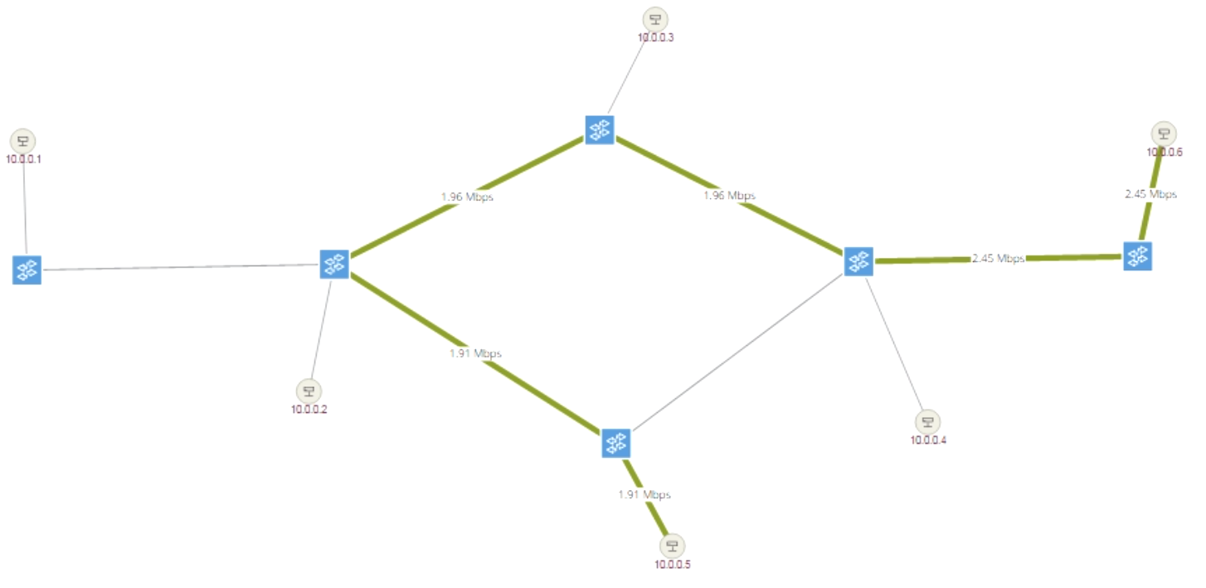
Result Case
Sender: 5Mbps
Sender: 2Mbps
Sender: 4Mbps
BW=4M
BW=10M
BW=5M
BW=4M
BW=2M
BW=10M

Slide 15
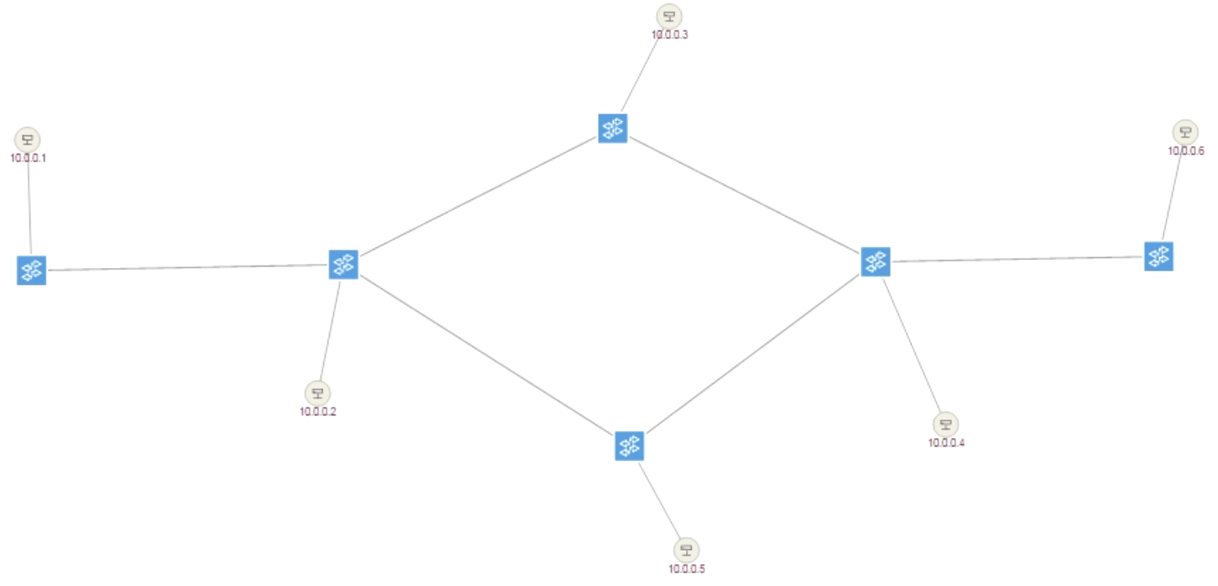
Result Case
Sender: 5Mbps
Sender: 2Mbps
Sender: 4Mbps
BW=4M
BW=10M
BW=5M
BW=4M
BW=2M
BW=10M

Slide 16
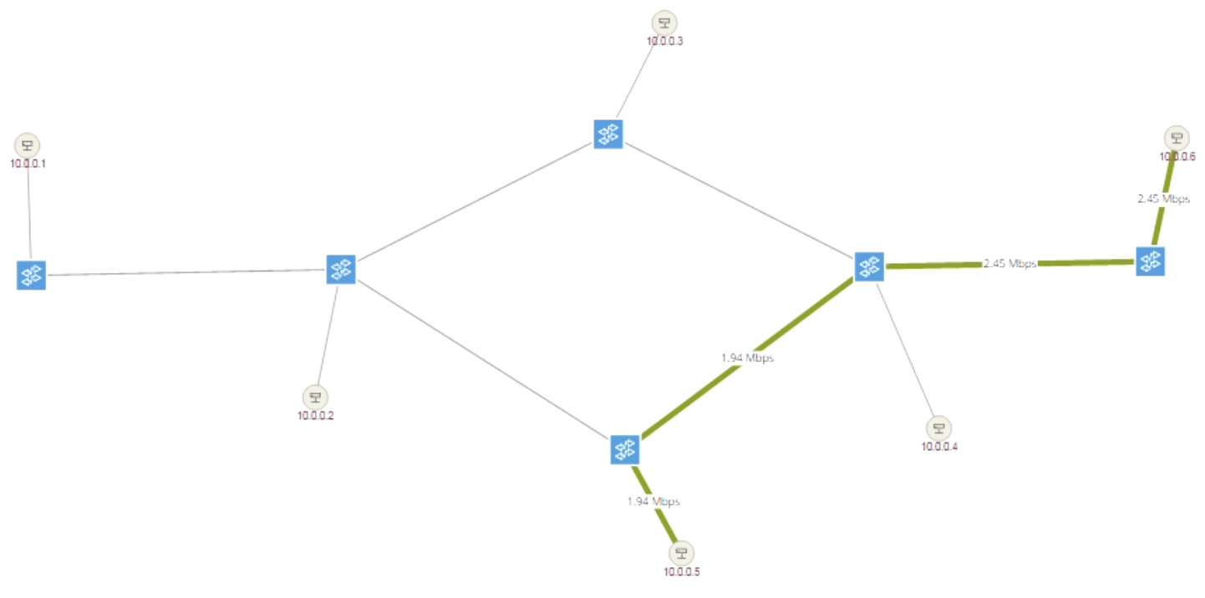
Result Case
Sender: 2Mbps
BW=4M
BW=10M
BW=5M
BW=4M
BW=2M
BW=10M

Slide 17
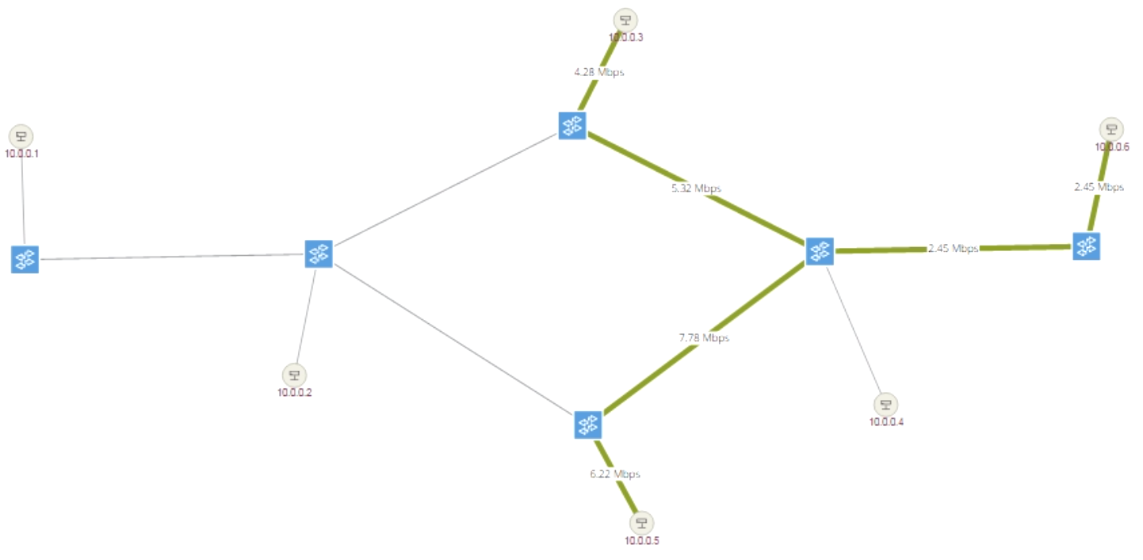
Result Case
Sender: 5Mbps
Sender: 2Mbps
BW=4M
BW=10M
BW=5M
BW=4M
BW=2M
BW=10M

Slide 18
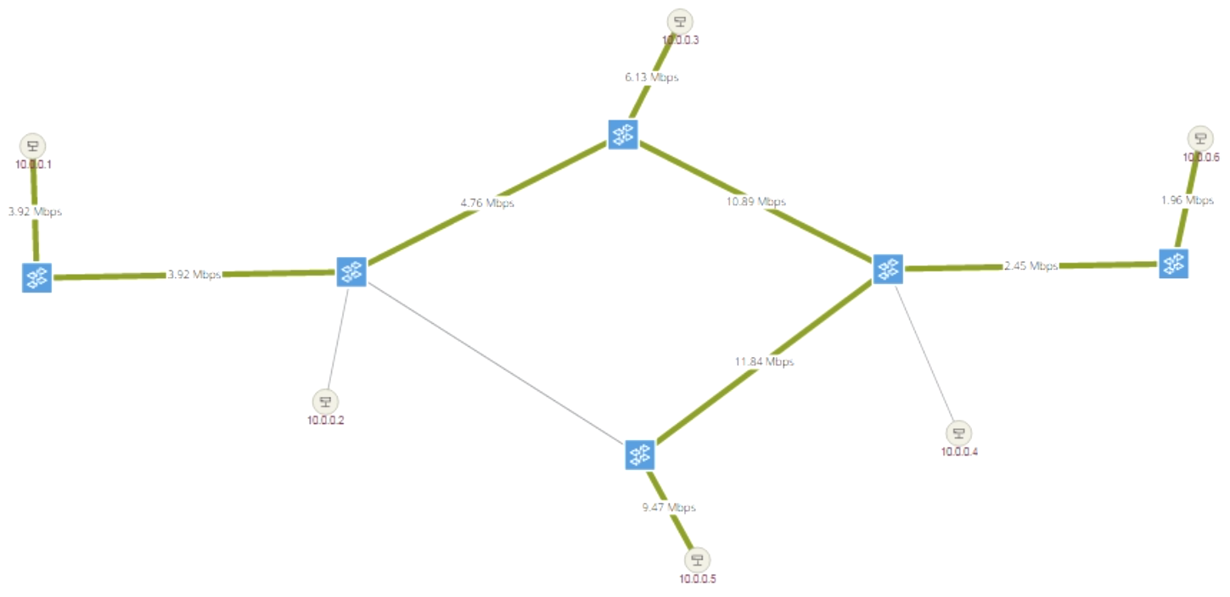
Result Case
Sender: 5Mbps
Sender: 2Mbps
Sender: 4Mbps
BW=4M
BW=10M
BW=5M
BW=4M
BW=2M
BW=10M

Slide 19
Result Case
Round 1 Statistics:
Sequence | Demand | Received | Packet Lost
s1 -> s5 | 4Mbps | 3.88Mbps | 0.14%
s3 -> s5 | 5Mbps | 5.00Mbps | 0.055%
s6 -> s5 | 2Mbps | 1.94Mbps | 0.039%
 | 1-2 | 2-1 | 2-3 | 3-2 | 2-5 | 5-2 | 3-4 | 4-3 | 4-5 | 5-4 | 4-6 | 6-4
Capacity | 5 | 5 | 4 | 4 | 2 | 2 | 10 | 10 | 10 | 10 | 5 | 5
Used BW | 4 |  | 4 | 2 | 2 |  | 4+5 | 2 | 4+5 |  |  | 2
Utilization | 80% |  | 100% | 50% | 100% |  | 90% | 20% | 90% |  |  | 40%
Total Demand: 11 Mbps
Demand Satisfaction: 11 Mbps

Slide 20
Result Case
Round 2 Statistics:
Sequence | Demand | Received | Packet Lost
s6 -> s5 | 2Mbps | 1.87Mbps | 5.4%
s3 -> s5 | 5Mbps | 4.77Mbps | 4.7%
s1 -> s5 | 4Mbps | 3.88Mbps | 2.8%
 | 1-2 | 2-1 | 2-3 | 3-2 | 2-5 | 5-2 | 3-4 | 4-3 | 4-5 | 5-4 | 4-6 | 6-4
Capacity | 5 | 5 | 4 | 4 | 2 | 2 | 10 | 10 | 10 | 10 | 5 | 5
Used BW | 4 |  | 4 |  |  |  | 5+4 |  | 2+5+4 |  |  | 2
Utilization | 80% |  | 100% |  |  |  | 90% |  | 110% |  |  | 40%
Total Demand: 11 Mbps
Demand Satisfaction: 10 Mbps

Slide 21
Assessment of Widest Remaining Bandwidth
We come up with this simple but practical routing strategy which takes advantage of SDN’s global information.
Pros:
Try its best to avoid congestion and satisfy more flow
demands.
Cons:
- Only one path is selected so the width may not be fully
used. (May Improve using multiple paths)
- No adjustment to established flows so the result may not
be the optimal. (Improve using LP to find global optimal)

Slide 22
To Do Next
Multipath Optimal Allocation
- Consider link bandwidth and flow demands
- Linear programming to maximize total flow traffic
Referring to SWAN paper, but simplifies it.
Not considering traffic priority.
Tolerate the packet loss when flow rules change after LP calculation.
An improvement of widest remaining bandwidth (If have time)
- Multiple paths
- Load balanced allocation of flow demand.
- Lower the maximum utilization of the paths after the flow joins.

